Slide 1
Seasonal Analysis
Agriculture
Performance
Student Name: CHALLURI ROHAN
College Name: VAAGDEVI COLLEGE OF ENGINEERING
AICTE STU ID :STU66c0d295d67d51723912853
9/4/2026 Annual Review
1

Slide 2

PROBLEM STATEMENT
Agricultural performance is shaped by seasonal variation in rainfall, temperature, soil conditions and resource availability.
Raw farm-level data does not clearly reveal how yield, cost and profit differ between the Kharif, Rabi and Zaid seasons.
Problem: analyze seasonal agriculture data to uncover meaningful patterns, trends and relationships in performance across seasons.
Goal: support evidence-based, season-specific agricultural planning and decision-making.
9/4/2026
Annual Review
2

Slide 3
Project Description
Dataset: 4,000 farm-level records spanning 8 Indian states, 8 crops and 3 cropping seasons — Kharif, Rabi and Zaid.
Captures environmental conditions (rainfall, temperature, humidity, soil), resource usage (water, fertilizer, pesticide), and economic outcomes (cost, revenue, profit).
Objective: clean and explore the data, identify seasonal patterns and relationships, and derive evidence-based recommendations for seasonal agricultural planning.
Approach: exploratory data analysis, statistical testing (ANOVA) and visualization using Python, documented end-to-end in a Jupyter Notebook.
9/4/2026 Annual Review

Slide 4

WHO ARE THE END USERS?
Farmers & Agronomists
Plan crop selection, irrigation and inputs season-by-season using evidence rather than guesswork.
Agricultural Policy Makers
Design seasonal advisories, subsidies and irrigation programs backed by real performance data.
Agribusiness & Supply Chains
Anticipate seasonal shifts in production volumes and pricing to plan procurement and logistics.
Researchers & Students
Use the findings as a reference case study on data-driven seasonal agricultural analysis.
9/4/2026 Annual Review

Slide 5


Technology Used
Python — Core programming language for the entire analysis
Pandas & NumPy — Data cleaning, transformation and numerical computation
Matplotlib & Seaborn — Statistical charts, boxplots, heatmaps and trend visualizations
SciPy — ANOVA and correlation testing for statistical significance
Jupyter Notebook — End-to-end documentation of the analysis workflow
9/4/2026 Annual Review

Slide 6
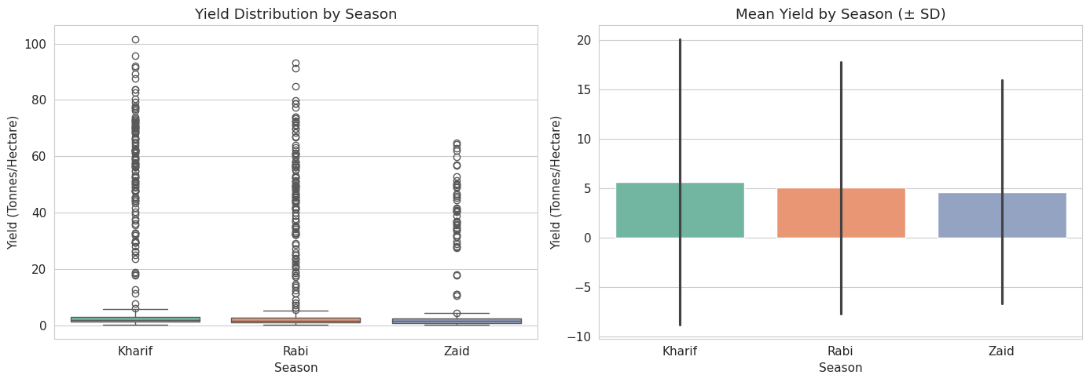
RESULTS
Yield Performance by Season
Kharif records the highest average yield (5.64 t/ha), aided by monsoon rainfall; Zaid is lowest (4.67 t/ha). A one-way ANOVA confirms this difference is statistically significant (p < 0.05).
9/4/2026 Annual Review

Slide 7
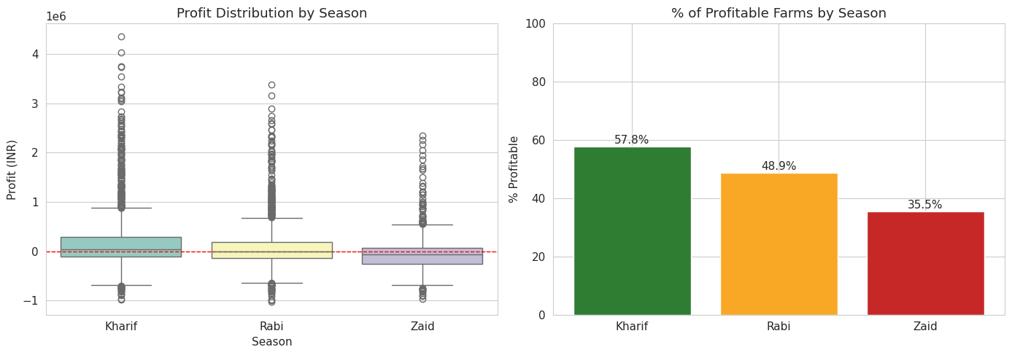
RESULTS
Economic Performance by Season
Kharif is the most profitable season on average (₹1,78,915; 57.8% of farms profitable). Zaid runs a net loss on average (-₹24,805) with only 35.5% of farms profitable.
9/4/2026 Annual Review

Slide 8
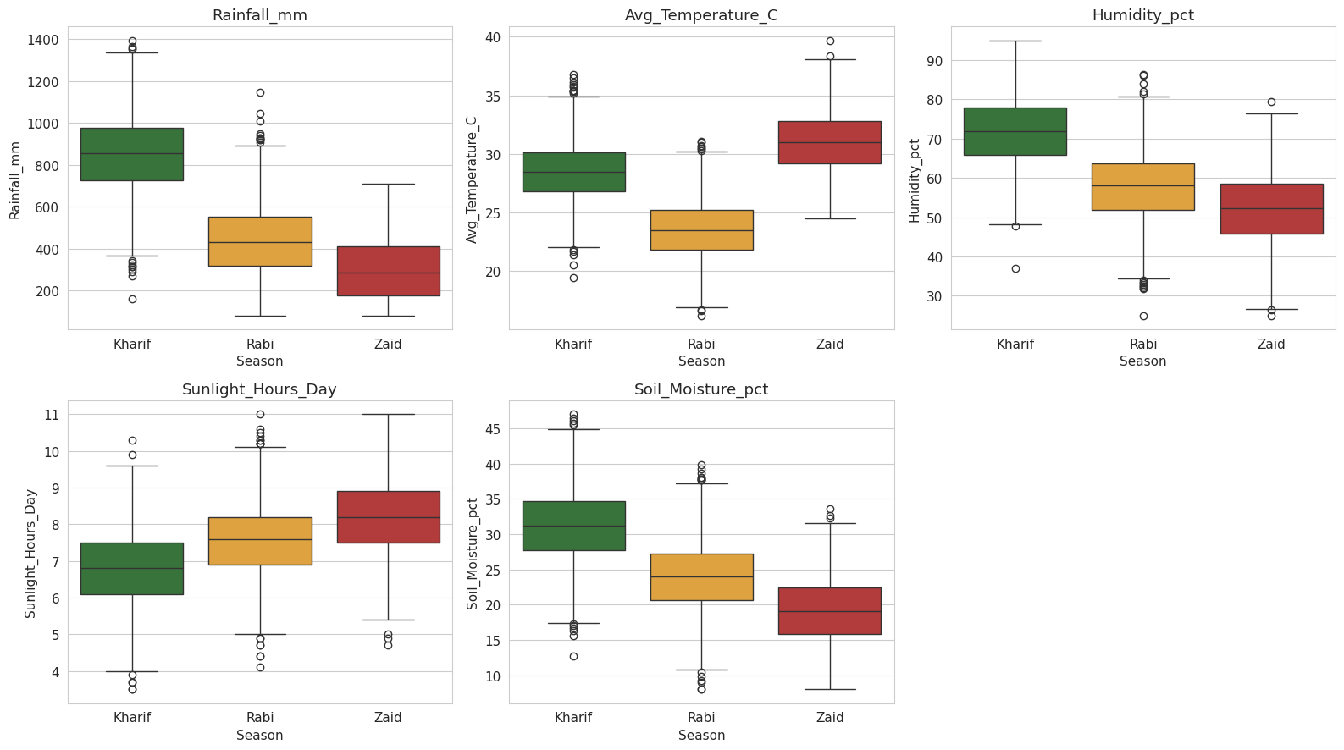
RESULTS
Environmental Conditions by Season
Kharif brings high rainfall and humidity from the monsoon; Zaid is hottest with the least rainfall and soil
moisture — the primary driver of the seasonal yield and profit gap.
9/4/2026 Annual Review

Slide 9
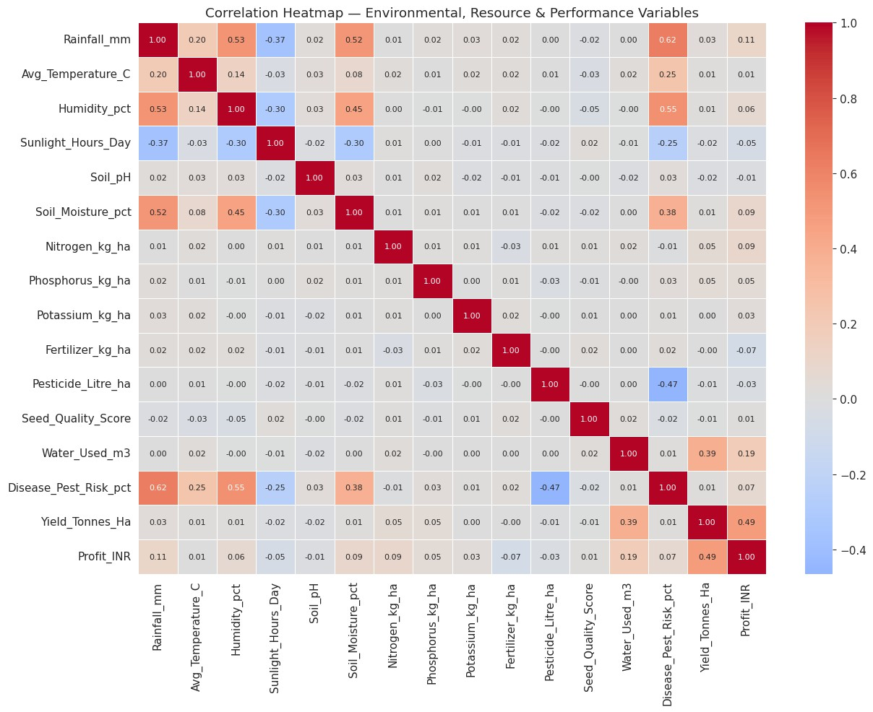
RESULTS
Relationships Between Key Variables
Yield correlates most strongly with water usage (r = 0.39); disease/pest risk rises sharply with rainfall
and humidity (r ≈ 0.6), linking wetter seasons to higher crop risk.
9/4/2026 Annual Review

Slide 10
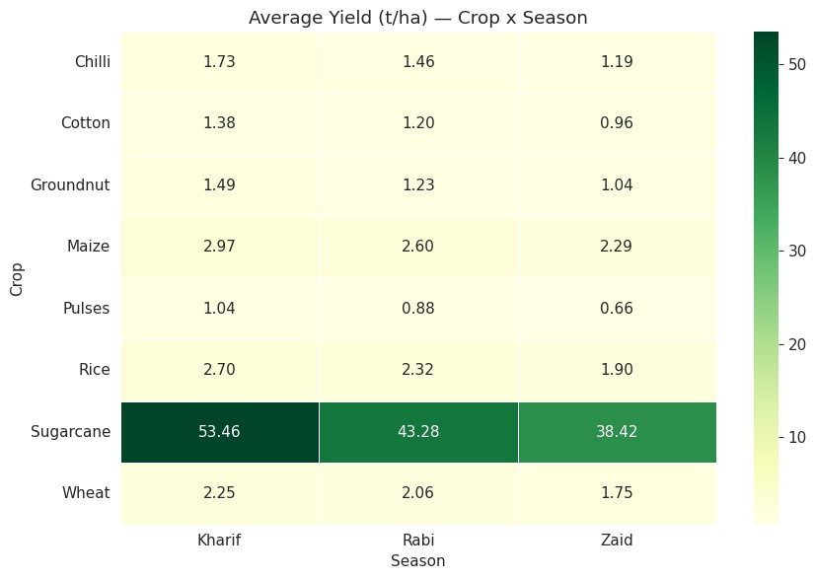
RESULTS
Crop Performance Across Seasons
Sugarcane shows the largest seasonal swing in yield, while most states also perform best in Kharif — confirming the seasonal effect holds consistently across crops and regions.
9/4/2026 Annual Review
10

Slide 11
Future scope
Incorporate multi-year data to separate genuine seasonal effects from single-year weather anomalies.
Build predictive models (machine learning) to forecast yield and profit by season ahead of planting.
Develop an interactive dashboard for real-time, season-
wise monitoring of farm performance.
Extend the analysis to district-level micro-climate and soil-type factors for finer-grained insight.
Integrate market price forecasting with seasonal supply patterns to guide sell-timing decisions.
9/4/2026 Annual Review

Slide 12
GitHub Link
https://github.com/Rohanchalluri/Seasonal_Agriculture_Performance_Analysis-.git
9/4/2026 Annual Review

Slide 13

VOIS Course completion certificate - Course name- Data Visualization
9/4/2026 Annual Review

Slide 14

Thank you
.
.
9/4/2026
Annual Review

